Slide 1

Enhancing Stock Price Prediction for Nifty 50 IT Sector Companies: A Comparative Study of ML Models with Feature Selection and Event Data Integration Economics and Finance
Second Review
Course Code: CS6510
Course Title: Project 1
24MSP3038
Aniket Shinde
3/12/2024

Slide 2
Abstract
This study addresses the challenge of predicting stock prices in the volatile IT sector of the Nifty 50 index, where traditional models based solely on historical data often fail to account for influential market events, such as economic policy shifts, earnings reports, and global economic changes. By incorporating event-driven data into predictive models, this research aims to improve the accuracy of stock price forecasting for IT companies, providing a more responsive tool for market analysis. Specifically, we evaluate the performance of ARIMA, SARIMA, GRU, and LSTM models, integrating event-driven and sentiment-based features through feature selection to identify the most impactful variables. The comparative analysis of these models across multiple performance metrics highlights the potential of event-enhanced LSTM models, demonstrating lower error rates and improved accuracy over baseline approaches. The findings contribute to existing financial literature by demonstrating how integrating external events and feature optimization can significantly improve stock forecasting accuracy. This study holds practical value for investors, analysts, and financial institutions, supporting more robust decision-making in high-volatility markets and setting a foundation for applying this predictive approach across other sectors.

Slide 3
Introduction
Stock price prediction, particularly in the Nifty 50 IT sector, is a challenging task due to the high volatility of financial markets and the profound impact of market-moving events. This problem is critical for investors, analysts, and policymakers aiming to make informed decisions in a dynamic and competitive environment. While traditional models like ARIMA and SARIMA have been widely used for time series forecasting, emerging techniques such as GRU and LSTM have shown promise in capturing complex temporal patterns. Moreover, prior research has rarely integrated event-driven data into stock price prediction frameworks, leaving a gap in fully leveraging external factors that influence market movements.
To address these challenges, we propose a comprehensive approach combining advanced machine learning models and event data integration for enhanced predictive accuracy. Our contributions include a comparative study of traditional and deep learning models and a novel integration of event-driven insights into the forecasting process. By utilizing all available features to their fullest extent, this research aims to provide actionable insights and improve forecasting precision in the IT sector, which holds significant importance in the Indian financial landscape.

Slide 4
Need of study
The Nifty 50 IT sector, a vital component of the Indian economy, faces challenges in accurate stock price prediction due to high volatility and the impact of external events. Existing models often fall short in capturing the nuanced influence of these factors.
This study addresses this gap by combining advanced machine learning with event-driven insights. By analyzing the impact of external events, we aim to improve forecasting accuracy, empower informed decision-making, and contribute to a deeper understanding of market dynamics. Additionally, this study will demonstrate the advantage of Recurrent Neural Networks (RNNs) like GRU and LSTM in effectively capturing complex market movements and temporal dependencies.

Slide 5
Problem Statement
Predicting stock prices in the Nifty 50 IT sector is challenging due to high volatility and the impact of market-moving events, making it necessary to use models that integrate event-driven data for improved accuracy

Slide 6
Objectives
This study aims to develop a robust predictive framework for stock price forecasting in the Nifty 50 IT sector by leveraging machine learning models and event-driven data. The primary focus is on stock prices as the dependent variable, with predictors including daily returns, trading volume, and event-driven data such as economic announcements and global news. By implementing and comparing ARIMA, SARIMA, GRU, and LSTM models, the study seeks to assess predictive accuracy and demonstrate the advantage of RNNs in capturing complex market movements influenced by external factors.
The scope includes analyzing stock performance from 2006 to the present, focusing on major IT companies within the Nifty 50. The study identifies significant external events contributing to market fluctuations and evaluates model performance using metrics like RMSE, MAPE, and R-squared. To maintain clarity, the study avoids redundant variables and excludes minor events with negligible impact, ensuring that only strictly necessary data is considered. This approach systematically addresses the research problem while providing actionable insights into market dynamics.

Slide 7
Related Work
Describe in detail existing work related to your problem, how they are related to each other, and how your work relates to these. We expect this to be comprehensive and thorough, and with at least 10 citations discussed and cited accordingly.

Slide 8
Proposed Methodology [ Max. 3 Slides ]
Design/Architecture Diagram
Thoroughly describe the methods that you intended to use in your approach, and the baselines you plan to compare against.

Slide 9
Dataset
Source of the Dataset: Yahoo Finance API
No. of Observations: 4495
Column/Feature Details: Date, HCLTECH.NS_Adj Close, INFY.NS_Adj Close, TCS.NS_Adj Close, TECHM.NS_Adj Close, WIPRO.NS_Adj Close, HCLTECH.NS_Close, INFY.NS_Close, TCS.NS_Close, TECHM.NS_Close, WIPRO.NS_Close, HCLTECH.NS_High, INFY.NS_High, TCS.NS_High, TECHM.NS_High, WIPRO.NS_High, HCLTECH.NS_Low, INFY.NS_Low, TCS.NS_Low, TECHM.NS_Low, WIPRO.NS_Low, HCLTECH.NS_Open, INFY.NS_Open, TCS.NS_Open, TECHM.NS_Open, WIPRO.NS_Open, HCLTECH.NS_Volume, INFY.NS_Volume, TCS.NS_Volume, TECHM.NS_Volume, WIPRO.NS_Volume
Details about the columns:
Date: Discrete (time-series feature)
Price-related columns (Adj Close, Close, High, Low, Open): Continuous
Volume columns: Discrete (countable values)

Slide 10
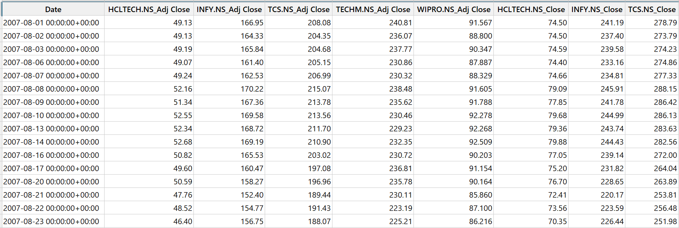
Dataset
Screenshot of the dataset

Slide 11
Results and Discussion [ No MAX Limit for number of slides]
Methodology Used
Output
Interpretation
Describe any preliminary results up to the time of the milestone. You should show the results of training at least one deep learning model. (It is fine if the model has not yet attained good performance.) You should also show preliminary analysis on the model(s) that you have trained. You should also describe anticipated next steps and any obstacles that have come up.

Slide 12
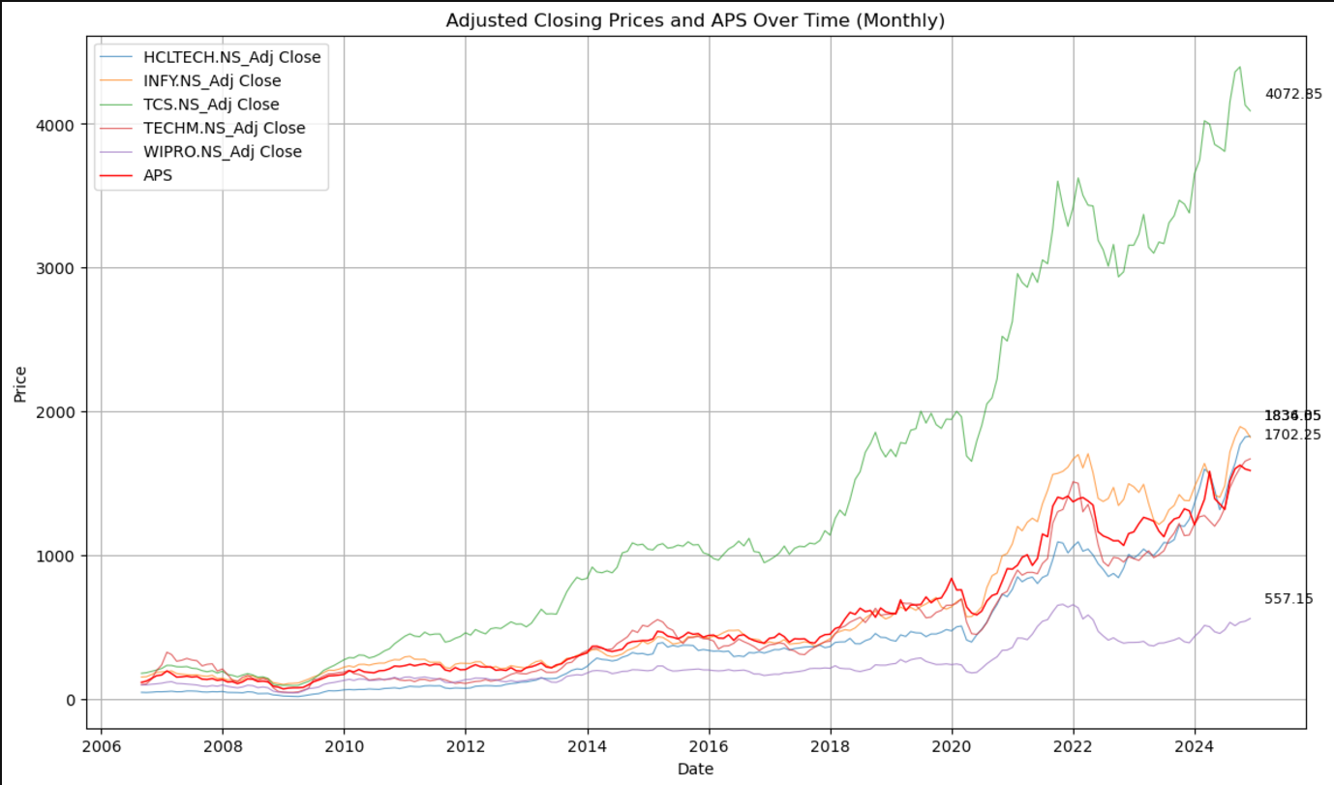
Exploratory Data Analysis
The time series plot shows an overall upward trend in the adjusted closing prices of major Indian IT companies, with significant growth after 2020 and notable divergence between companies. Key events include a dip during the 2008 financial crisis and a sharp drop and recovery during the COVID-19 pandemic.

Slide 13
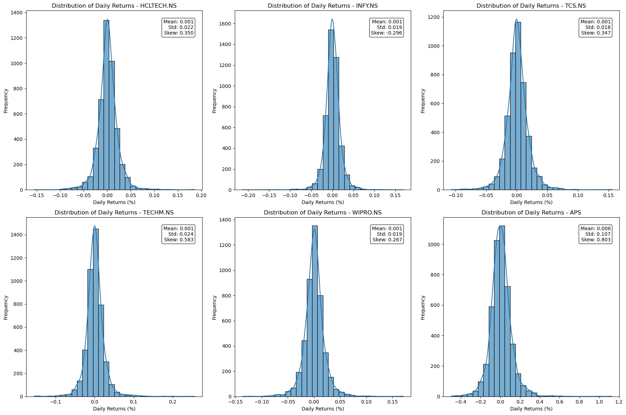
Exploratory Data Analysis (cont.)
The histograms of daily returns for all stocks show a bell-shaped distribution centered near zero, indicating that small daily price changes are most common, with rare extreme movements.

Slide 14
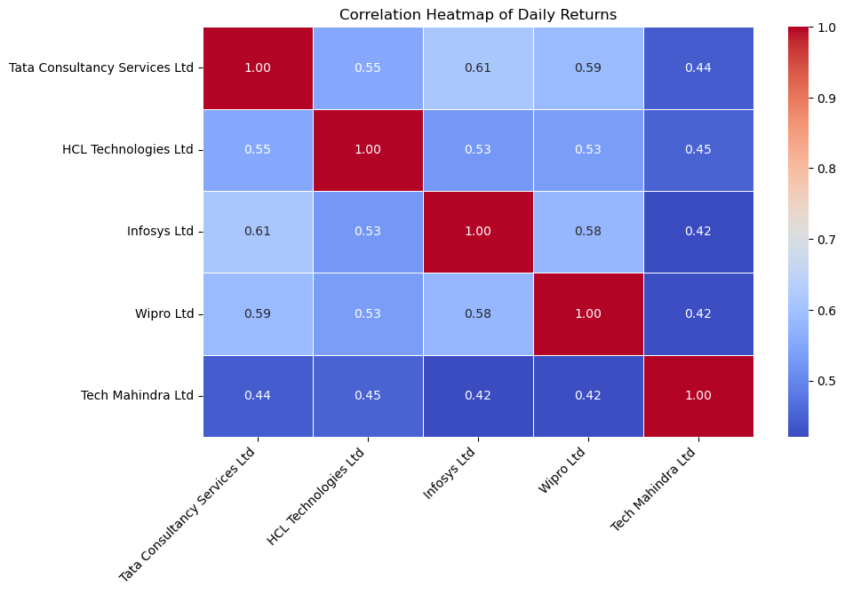
Exploratory Data Analysis (cont.)
The correlation matrix shows moderate to strong positive relationships between the stocks of major Indian IT companies, with Infosys and Tata Consultancy Services exhibiting the highest correlation at 0.61.

Slide 15
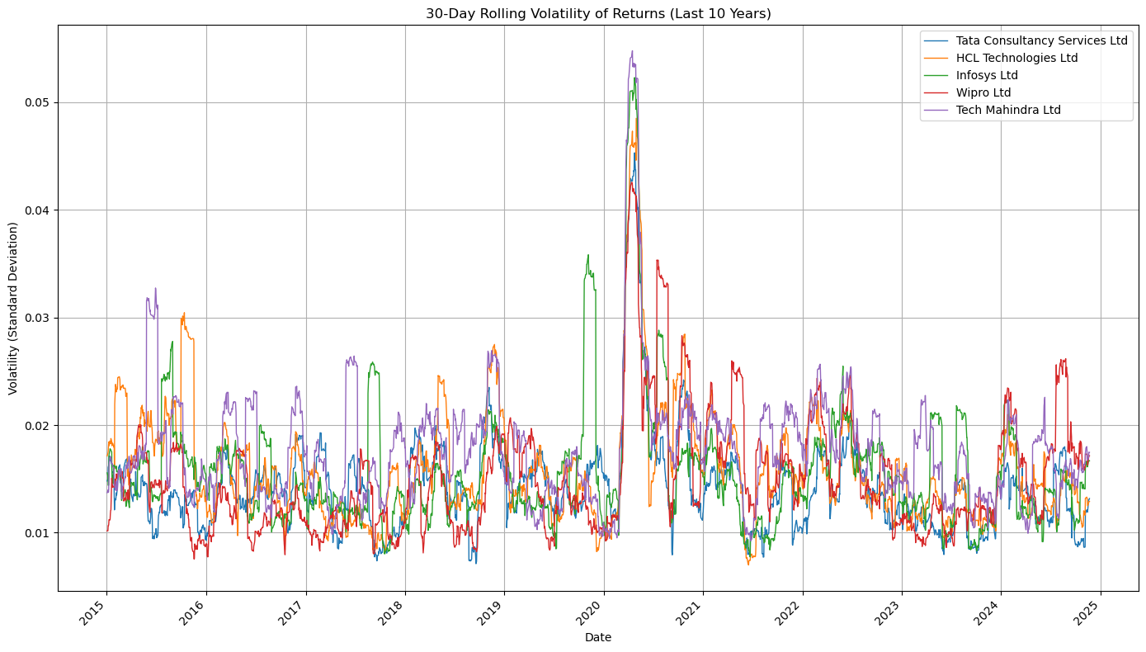
Exploratory Data Analysis (cont.)
This 30-day rolling volatility plot highlights the uncertainty in the stock market around the time of the COVID-19 pandemic lockdowns.

Slide 16
Performance Analysis
Model | R-squared | Mean Squared Error
ARIMA | -0.19 | 42199.93
SARIMA | -1.15 | 75829.18
GRU | 0.468 | 18856.15
LSTM | 0.403 | 20845.28

Slide 17
Conclusion
Predicting market movements is challenging due to financial data's volatile and non-linear nature. Traditional models like ARIMA and SARIMA struggle with multivariate data and overfitting. However, GRU and LSTM models significantly improve predictive performance by integrating multiple features and leveraging sequential dependencies. These models' flexibility in hyperparameter optimization and handling external influences enables them to capture complex patterns effectively. This project showcases the superiority of RNNs, highlighting their potential for reliable stock market predictions through data preprocessing and model tuning.

Slide 18
Future Enhancement
In the future, I plan to enhance data quality by exploring alternatives to dropping rows or using methods like forward filling for missing data. Since GRU and LSTM models have shown promise in capturing stock market trends, I aim to fine-tune their hyperparameters to achieve more accurate predictions. From my review of research papers, I discovered that hybridizing these two RNN models can be highly effective, as each has distinct strengths and weaknesses. Additionally, as market sentiment is a stronger indicator of stock price movements than one-dimensional numerical data, I also intend to integrate sentiment-driven analysis into the predictive framework.

Slide 19
References : APA format
Base Paper:
Mohan, B., Yadav, A., Toleti, J., Reddy, D. S. S., Ahmed, R. K., & Koushitha, G. (2024). Sentiment-driven predictive models for Nifty 50 stock market fluctuations: A time series analysis perspective. IEEE International Conference on Information Technology, Electronics and Intelligent Communication Systems (ICITEICS), 70, 1–8. https://doi.org/10.1109/iciteics61368.2024.10625537
Link to Paper
Paper I:
Panchal, S. A., Ferdouse, L., & Sultana, A. (2024). Comparative analysis of ARIMA and LSTM models for stock price prediction. 2024 IEEE/ACIS 27th International Conference on Software Engineering, Artificial Intelligence, Networking and Parallel/Distributed Computing (SNPD), 240–244. https://doi.org/10.1109/snpd61259.2024.10673919
Link to Paper
Paper II:
Rajhans, A., Das, T., Kumar, A., & Sinha, B. B. (2024). Exploring the impact of financial news sentiment on stock price forecasting: A comparative deep learning approach. 2024 1st International Conference on Communications and Computer Science (InCCCS). https://doi.org/10.1109/incccs60947.2024.10593315
Link to Paper
Paper III:
Taslim, D. G., Tjahyadi, H., & Murwantara, I. M. (2024). A study of LSTM optimisation for forecasting volatile time series data. 2024 4th International Conference on Computer Communication and Artificial Intelligence (CCAI). https://doi.org/10.1109/ccai61966.2024.10603183
Link to Paper
Paper IV:
Amruth, S. J., Nigelesh, T., Shruthik, V. S., Reddy, V. S., & Venugopalan, M. (2024). Time-series-based stock market analysis using machine learning. 2024 15th International Conference on Computing Communication and Networking Technologies (ICCCNT), 1–7. https://doi.org/10.1109/icccnt61001.2024.10725232
Link to Paper

